Slide 1
Human Computer Interaction
Principles of HCI

Slide 2
Why have a User Interface?
It helps the User to enter/edit/view and delete information in the database
Users do not have to understand how to use Access, only how to use the FORMS that you create in the Database.
You can control how the database system is used by different people and restrict access to fields/tables and functions of the DBMS depending on the security level of the user
Minimise possible errors by the users by providing command buttons to perform tasks and providing help information.

Slide 3
Principles of HCI
  Know The User- Types of user, Design for user,
  Understand the task- Sequence or structure of subtask at high level for user
  Reduce Memory Load- Short term & Long term Memory
  Strive for Consistency –group data similarly from one application to the next;
  Remind User and Refresh Memory- Reminder for user
  Prevent Errors/ Reversal of action- Error free system or reversal action for user
  Naturalness- Natural language, 3D design
  Accuracy – Create a design that ensures the User has to finish each task;
  Attractiveness – Create a design that the user will enjoy using, or even be drawn to using.
  Ease of use –should be straightforward, requiring no extra effort;
  Effectiveness –application for specific purpose.
  Simplicity – Forms and reports should be uncluttered in a manner that focuses the users attention.

Slide 4
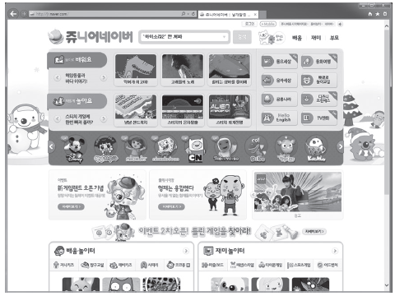
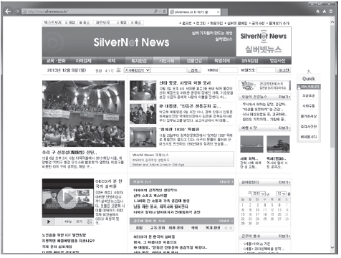
Know the User

Slide 5
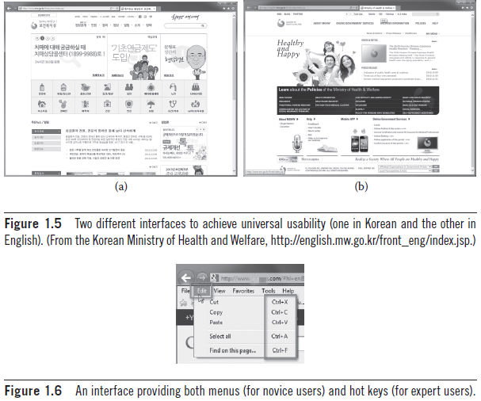
Know the User

Slide 6
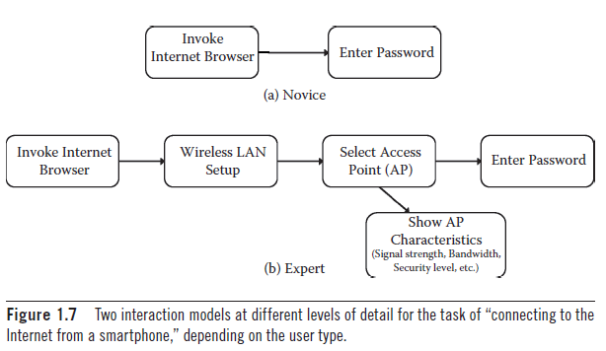
Understand the Task

Slide 7
Reduce Memory Load
lloia me ngineeringst udenthe
hello i am engineering student

Slide 8
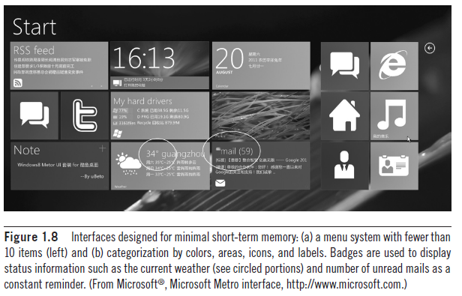

Slide 9
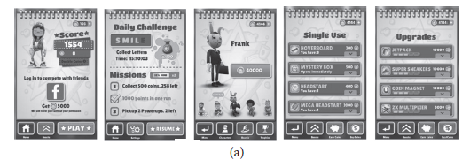
Strive for Consistency

Slide 10
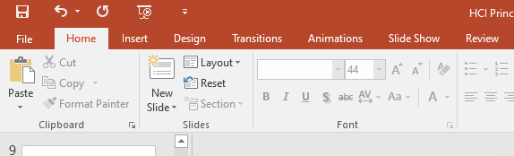
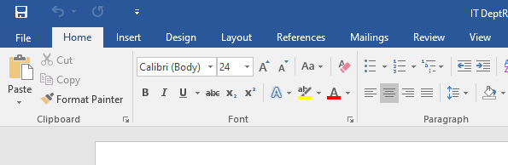

Slide 11
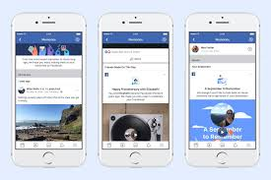
Remind Users and Refresh Their Memory

Slide 12
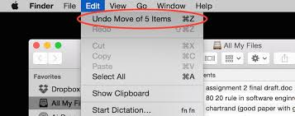
Prevent Errors / Reversal of Action

Slide 13
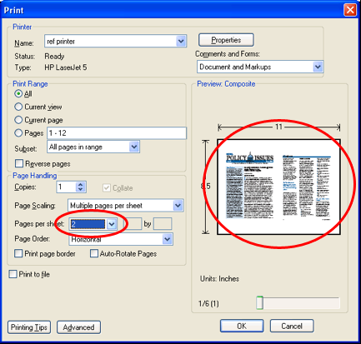
Naturalness
System Must behave as you expect

Slide 14
Consequences of poor interface design
User frustration
Low productivity
Stress
Under-utilisation of system
Increased mistakes in data entry

Slide 15
Definition of forms and reports
Form – a business document that contains some pre-defined data and may include some areas where additional data are to be filled in. An instance of a form is typically based on one database record.
Report – a business document that contains only predefined data; it is a passive document used solely for reading or viewing. A report typically contains data from many unrelated records or transactions

Slide 16
Fundamental questions when designing forms and reports
Who will use the form and report
What is the purpose of the form or report
When is the form or report needed and used
Where does the form or report need to be delivered and used
How many people need to use or view the form or report

Slide 17
Guidelines for the design of forms and reports
Meaningful titles – clear specific titles to describe the content and use of the form or report
Meaningful information – only needed information should be displayed not all of the fields on a table
Balance the layout – not all on one side
Design an easy navigation system – clearly show where you are and how to move forwards and backwards

Slide 18
How to Highlight information
Different colours
Different fonts
Size differences
Boxing
Underlining
ALL CAPITAL LETTERS
Off setting

Slide 19
Make Forms easy to fill out
Ensure that as you move from one field to another the form flows from left to right and/or top to bottom.
Group your information logically
Have a Heading /main body and then a sub form
Add command buttons that help the user to save/delete/create new records and close the form easily
Use the Caption property of a field to give information on what to enter into a field
Create labels to give further help information on the form
Use default values in your database fields to help the user fill out information quickly
Use validation on your database fields to make sure the user can only enter valid information

Slide 20
Forms should be attractive
Aesthetic forms draw people into them and encourage completion.
Forms should look uncluttered and appear organised and logical when filled in
Using different fonts, using separator lines, colour, and other features can help enhance the forms appearance
Follow the same colour scheme and layout on your forms

Slide 21
Benefits and problems of using colour
Benefits
  soothes or strikes the eye
  Accents
  Emphasises organisation of information
  Draws attention to warnings
Problems
  May cause problems for some users (colour blindness)
  Colour may degrade on different displays

Slide 22

Colour
Colour is very effective for highlighting, but must be used carefully.
Colours have a meaning
  Red - danger / warmth
  Green – normality
  Blue – cold

Slide 23
Colour and Design
Use background colours carefully
  The screen should not contain too much bright colour.
Don’t use too many colours on one screen
  do not exceed 6 different colours
Be consistent across the whole system
  one colour should not be used for more than one purpose.

Slide 24

Colour Hints
Colours which clash should be avoided e.g. purple with pink.
Care should be taken as 8% of men and 0.4% of women are colour blind, and have difficulty with colours such as green, red, and yellow.

Slide 25
Colour Hints (Cont)
Colour can be used to convey greater amounts of information more clearly
Colour should be used to improve user performance
Colour and brightness effect perceived size. Warm colours are larger (red, yellow). Cold colours are smaller (blue, green).

Slide 26

Bright Clashing Colours
Colours with insufficient contrast should be avoided e.g. yellow and white
Avoid text over pictures

Slide 27
Presentation And Contrast
Positive presentation is when the background is fairly subdued, i.e. white background, dark text
Negative presentation – dark background, white text.
A bright area on a dark background seems larger than the reverse.
Which is best???

Slide 28
Other Factors
Take care in spacing fonts, and choosing a correct font for screen use.
Letter Spacing
  |3 looks like a B. Space it out | 3
Some fonts can be difficult to read, and should be avoided.
You must be careful how you word things, so that they are not misinterpreted.

Slide 29
Legibility
Be concise. Icons need careful design in order to be understood
Avoid blinking, zooming or moving text
Font Size to be readable
Left Justified most of the text – can centre or right justify a few lines for effect
Sans Serif Fonts are more readable, but people prefer serif fonts.
Avoid Caps for text

Slide 30
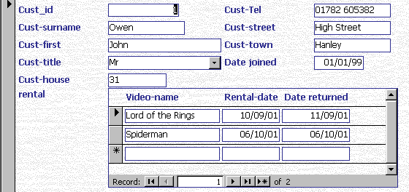
FORM CREATED USING A WIZARD
What are the bad features of this form design

Slide 31
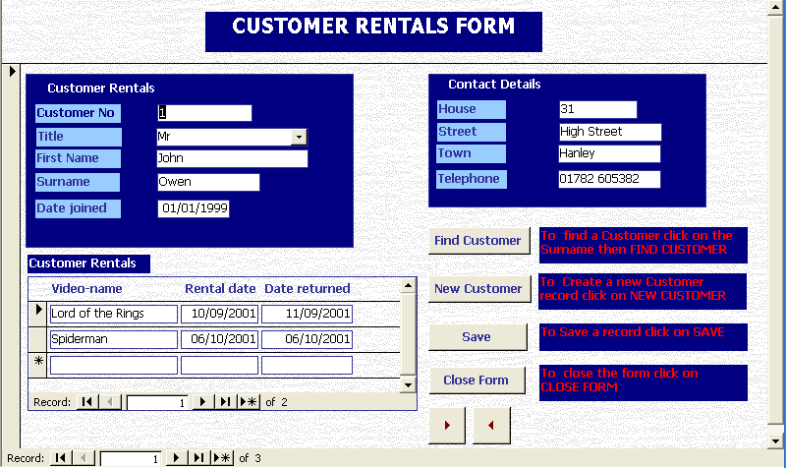
Improved Design

Slide 32
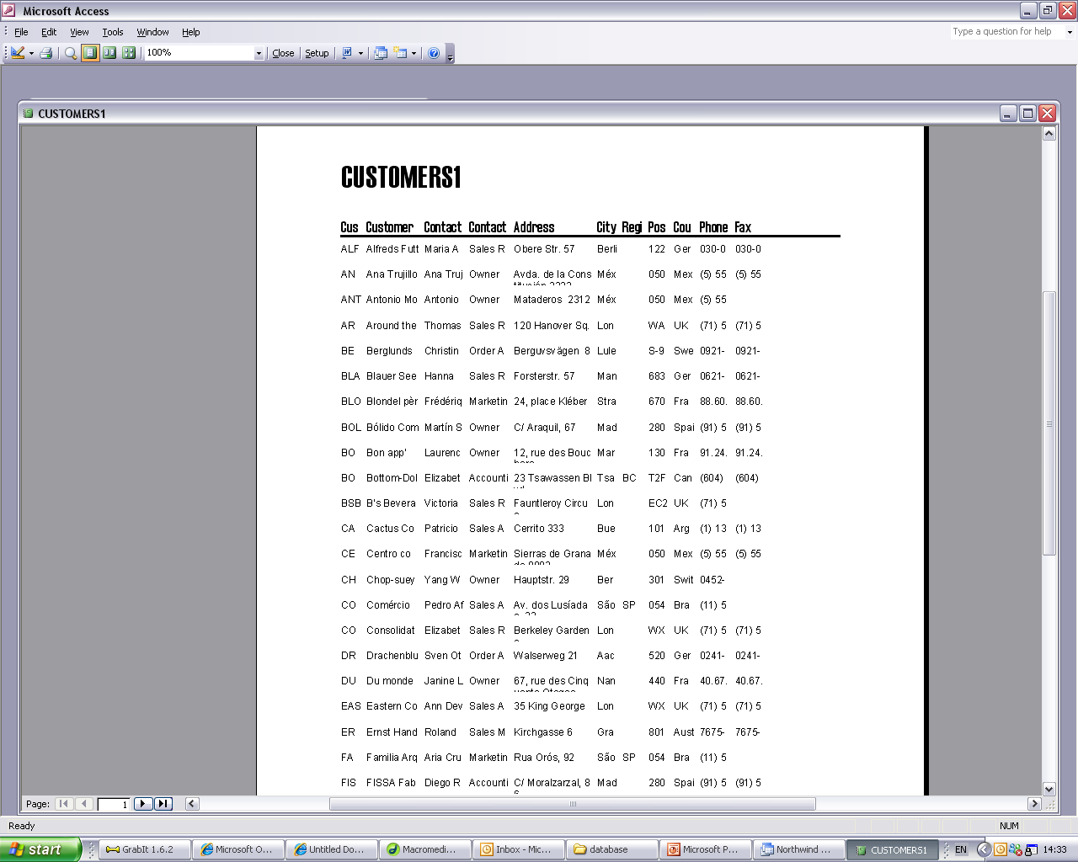
Report created using a wizard

Slide 33
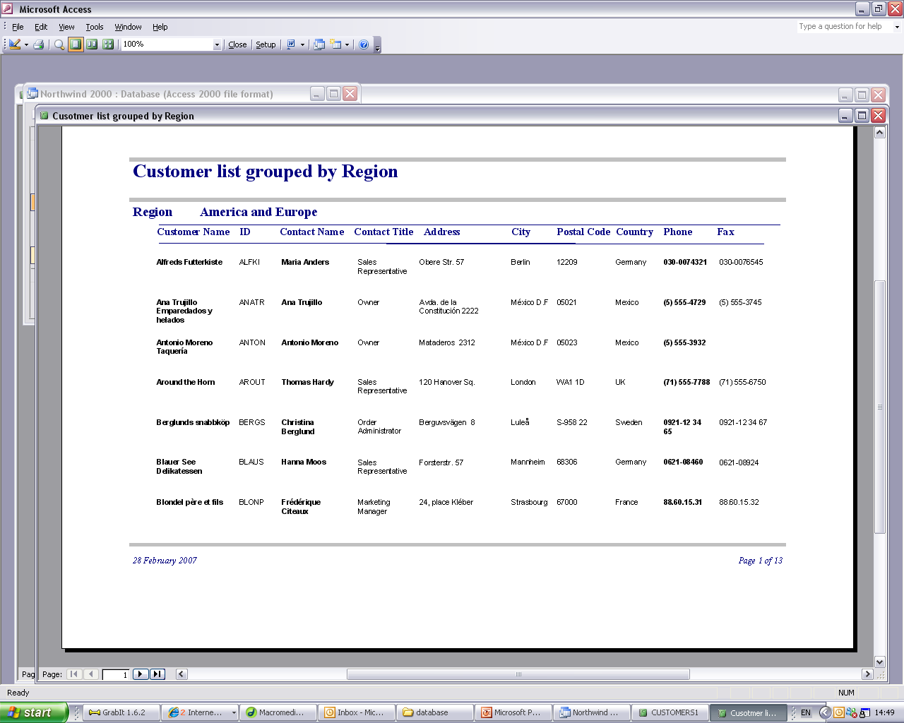
Improved design

Slide 34
Menu System
As well as producing good individual form/report design you need to plan an overall Menu System for your database
This should be designed with purpose of the database in mind, what is the database used for
What jobs need to be performed in the database?
  Think about the different jobs that the user of the DVD database has to perform and do a list

Slide 35
Example of tasks performed in the DVD Library
Enter/change DVD details
Enter/change Customer details
Enter new rentals for a Customer
Book rentals back from a Customer
Find out about DVD’s currently rented out
Find out about DVD’s not returned
Find out the value of all of the DVD’s in stock
Find out how much money has been made from renting DVD’s for one week/month/year

Slide 36
Group the tasks
Entering and changing details
  Enter/change DVD details
  Enter/change Customer details
Customer Rentals
  Enter new rentals for a Customer
  Book rentals back from a Customer
Database reports
  Find out about DVD’s currently rented out
  Find out about DVD’s not returned
  Find out the value of all of the DVD’s in stock
  Find out how much money has been made from renting DVD’s for one week/month/year

Slide 37
Menu system for Video Library
Main Menu
Editing/Changing
Information
Rentals
Reports
Enter/Change
DVD Details
Create new rental
DVD’s rented out
Enter/Change
Customer Details
Book DVD as Returned
DVD’s not returned
DVD stock value
Rental income

Slide 38
Creating the User interface
There are two ways of doing this
  Use the Switchboard Manager in Access
  Create the all of the Forms yourself

Slide 39
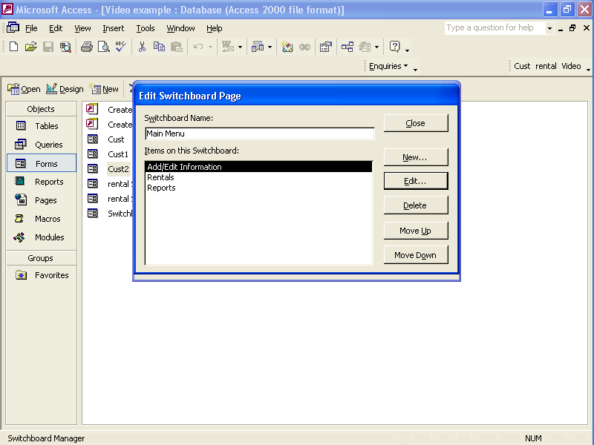
Creating the Switch board

Slide 40
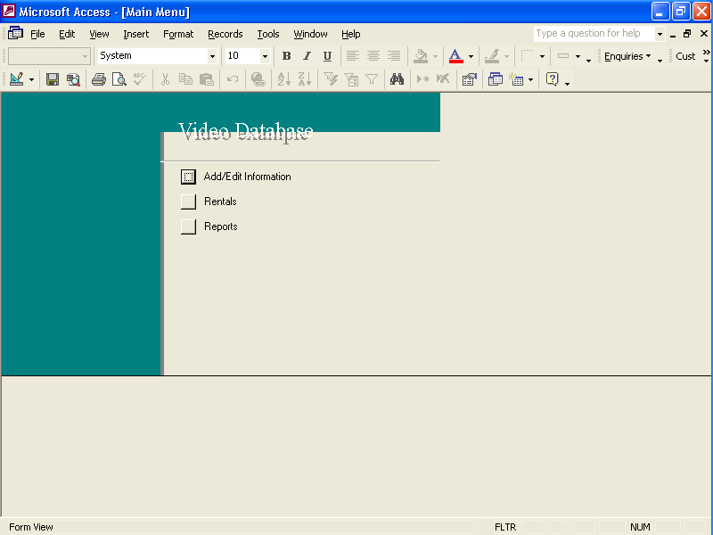
Main Menu Created

Slide 41
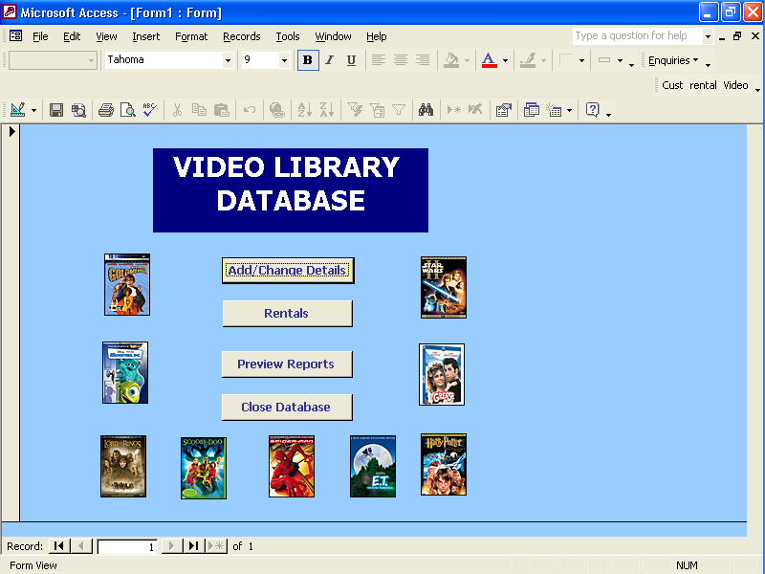
Example of Main Menu Form

Slide 42
Summary
Create an overall plan for your User Interface
The interface should be easy to navigate
Make sure that each form/report is designed with the User in mind – make them easy to use
Each form/report should perform a particular task
Add command buttons/help information/validation/default values to minimise mistakes.

